Slide 1
STADIUM TICKET BOOKING SYSTEM
DBMS LAB(CS-254) MINI PROJECT

Slide 2
Features of web application
1)There will be login and register pages initially
2)We will get list of matches in stadium by date,city,type of game.
3)Schedule: The whole schedule of current running matches.
4)Stadiums: we can also book the stadiums , if there is no match in that stadium on that day
5)Seat Availability: The people will also know how many seats are available and total number of seats of each category.
6) Payment: there will be a page for making payment and ticket will be generated after that ,which can be cancelled.

Slide 3
Implementation details:
Softwares used for front-end :
1)HTML
2)CSS(cascading style sheets)
3)Javascript
Softwares used for back-end :
1)Python
2)Django
3)MySQL

Slide 4
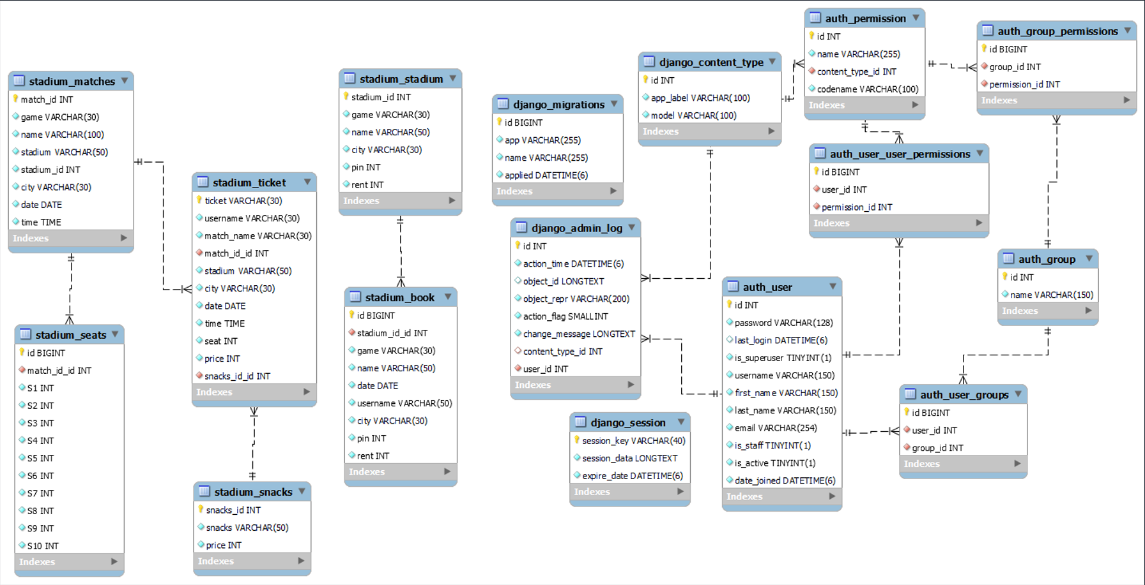
SCHEMA DIAGRAM :

Slide 5
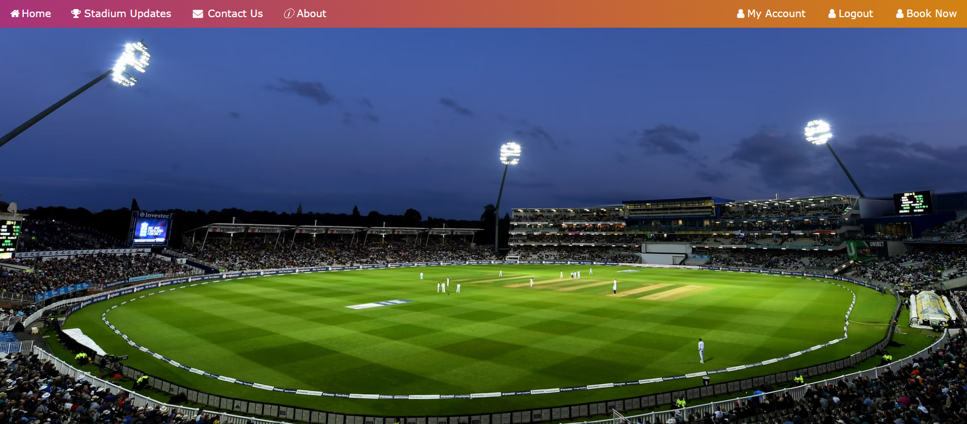
WEB SITE SCREENSHOTS

Slide 6
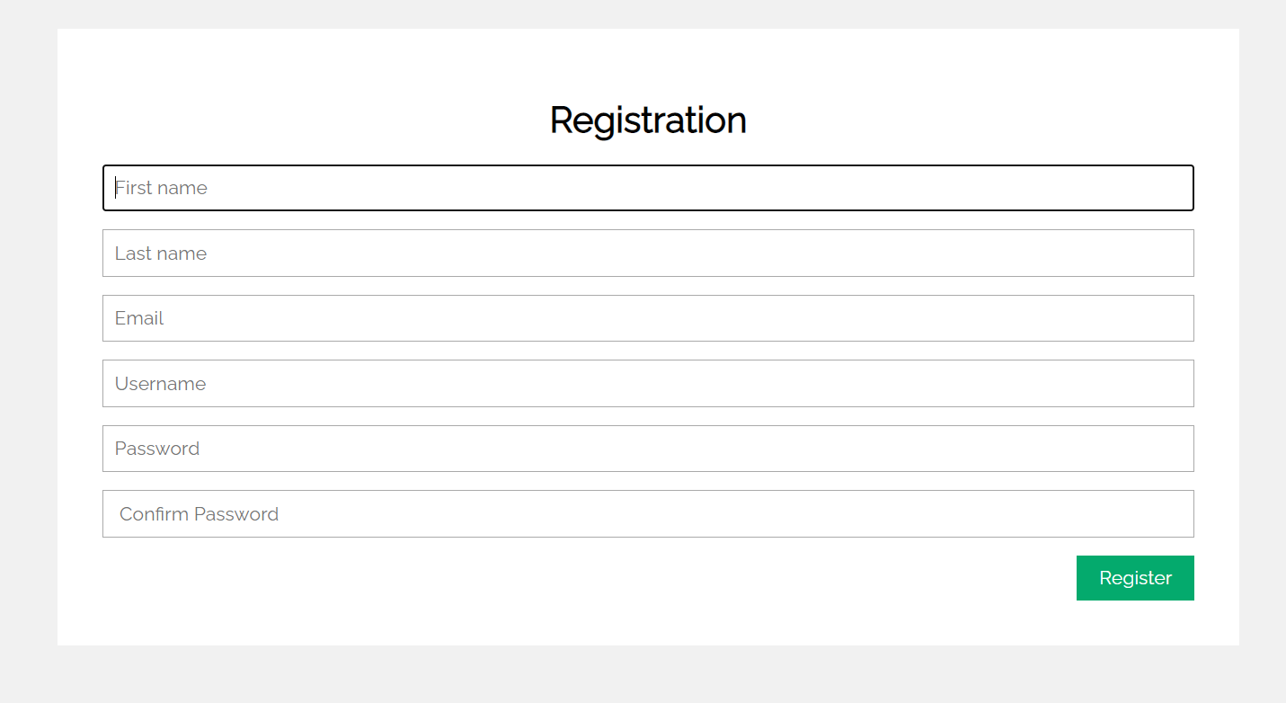
Registration page, user enters the following details

Slide 7
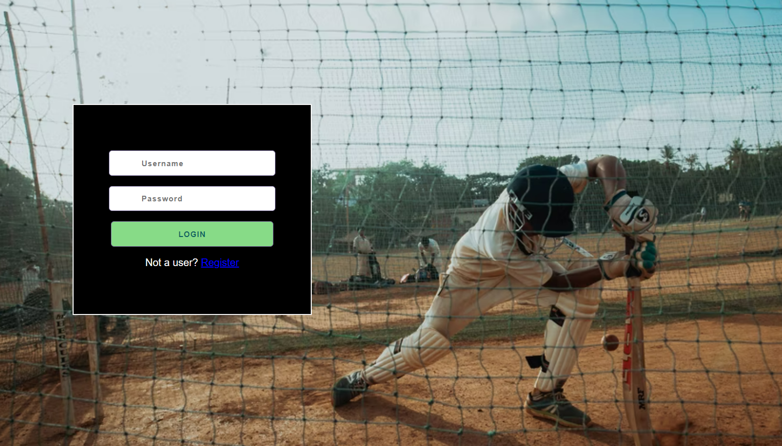
Login page

Slide 8
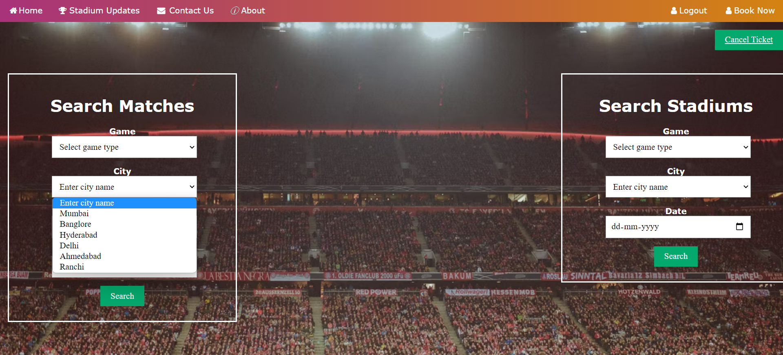
Here we can select the matches by date and city and game type
and we can also book stadiums if there is no match in that stadium

Slide 9
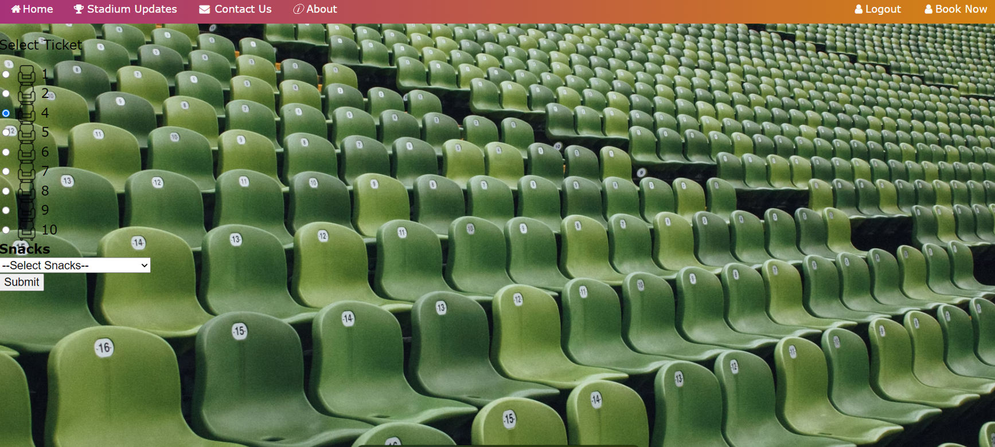
Here we can select seats , only one seat can be selected at a time

Slide 10
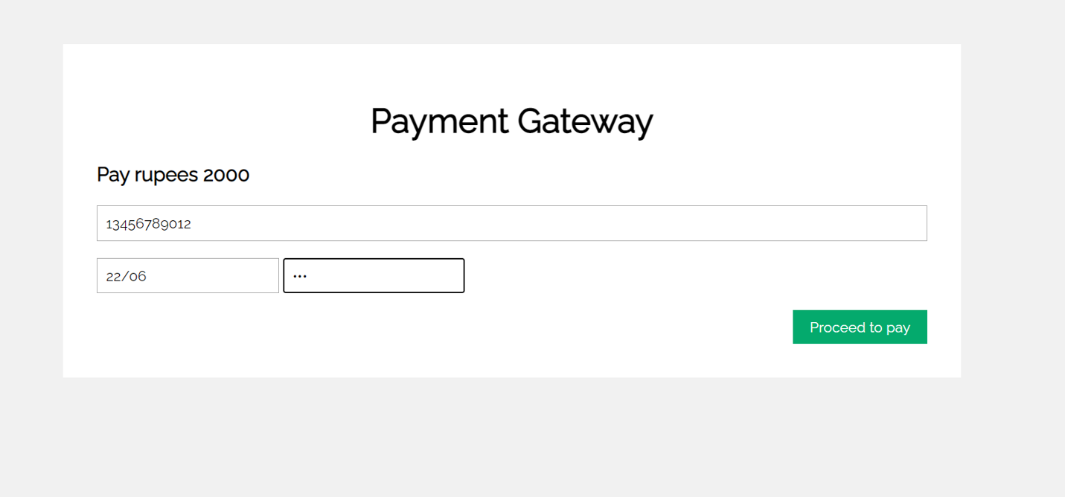
Payment page

Slide 11
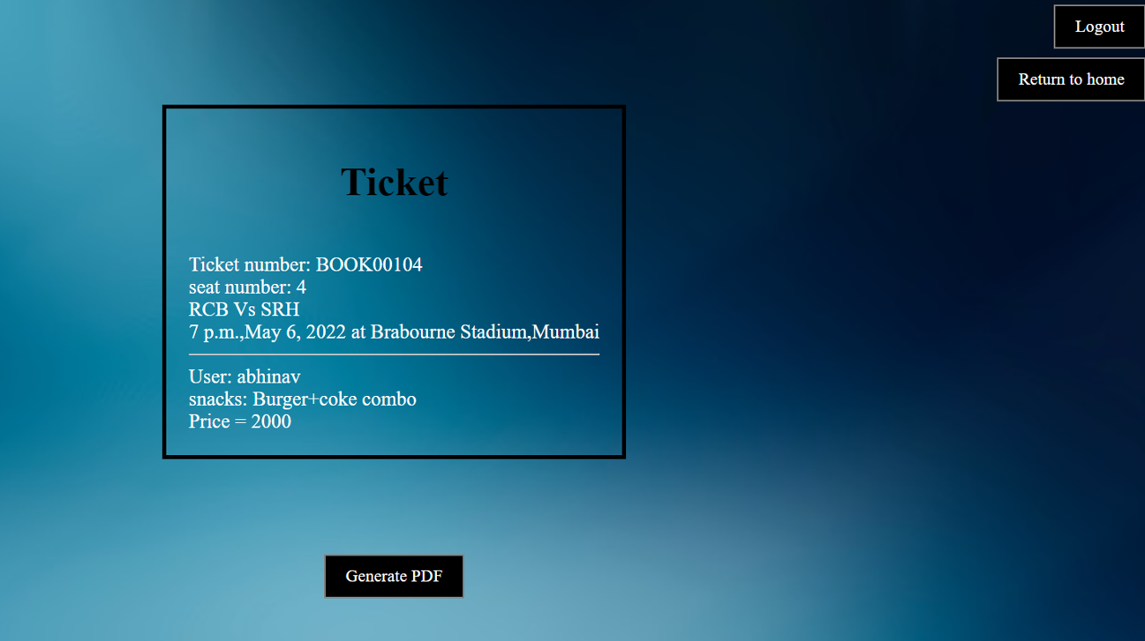
After payment we will be directed to this page

Slide 12
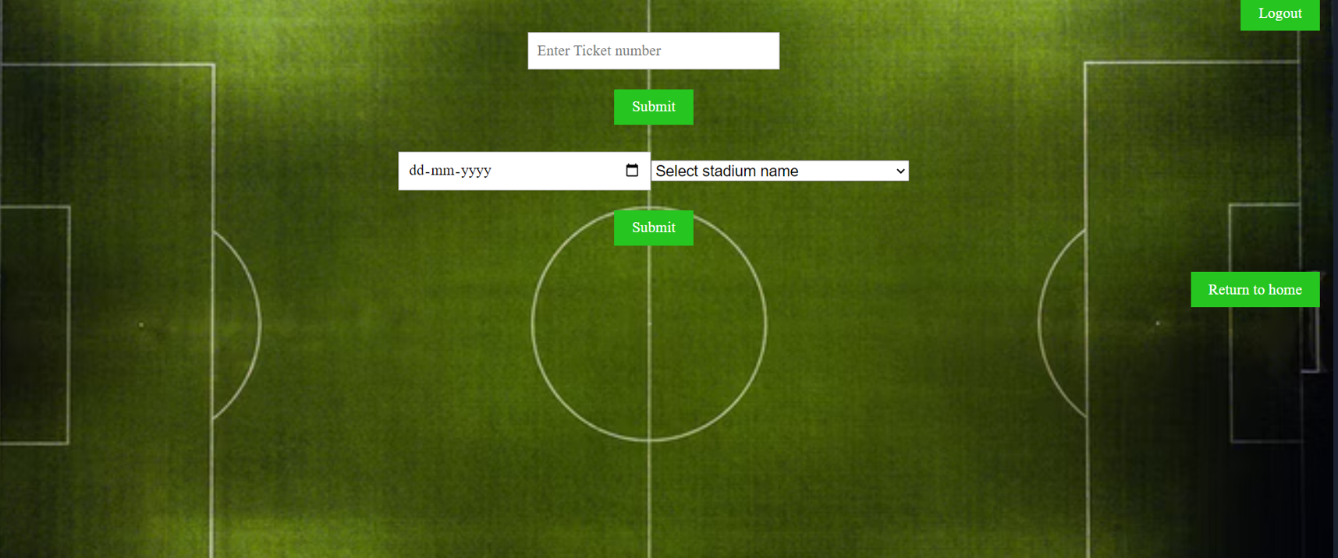
For cancelling the ticket

Slide 13
THANK YOU
Project done by:
P ABHINAV SAI - 201CS137
G. JAYA RAGA CHARAN - 201CS117
PV SATHWIK - 201CS140

